Slide 1


Talend Data Integration
Components for running system commands
Writing custom java code
How to review java code generated by Talend
Version control
Running Jobs
AUTHOR: SERGEY MOUKAVOZTCHIK
January, 2018

Slide 2
AGENDA
Components for running system commands
Writing custom java code
Custom code components
Global variables
Routines
How to review java code generated by Talend
Potential mistakes in components usage
How it can help to define problems
Version control
Running Jobs
Building a Job
Running a Job as standalone

Slide 3
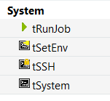
COMPONENTS FOR RUNNING SYSTEM COMMANDS
tSetEnv
add variables to system environment during the execution of a Job
tSSH
executes commands on remote environment via SSH
tSystem
Executes system commands

Slide 4
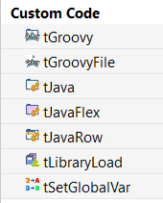
WRITING CUSTOM JAVA CODE
tJava – let you add portion of java code to your program
tJavaFlex - lets you add Java code to the Start/Main/End code sections of this component.
tJavaRow - lets you add enter customized code which process incoming rows and generate an output rows.

Slide 5
GLOBAL VARIABLES
Global variables could be set via tSetGlobalVar component. It let you add key-value pairs which will be stored in global map.
Optionally you save and retrieve a values from global map using java code:
globalMap.put("foo", "bar");
((String)globalMap.get("foo"));
When you read a data from global map you need to specify the data type

Slide 6
ROUTINES
Routines stored in the Repository as Java classes which contains public static methods.
All classes belong to package routines;
Each method of a class will be available in Talend jobs as a function
Text comments before the method define how routine will be displayed in GUI

Slide 7
HOW TO REVIEW JAVA CODE GENERATED BY TALEND
Potential mistakes in components usage
How it can help to define problems

Slide 8
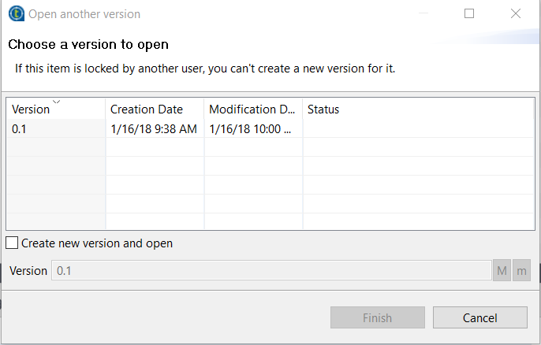
VERSION CONTROL
Version of a job could be changed or created using context menu – “Open another version”. You can specify a version of subjob you want to use in its settings or version of a job you want to build during a build process.

Slide 9
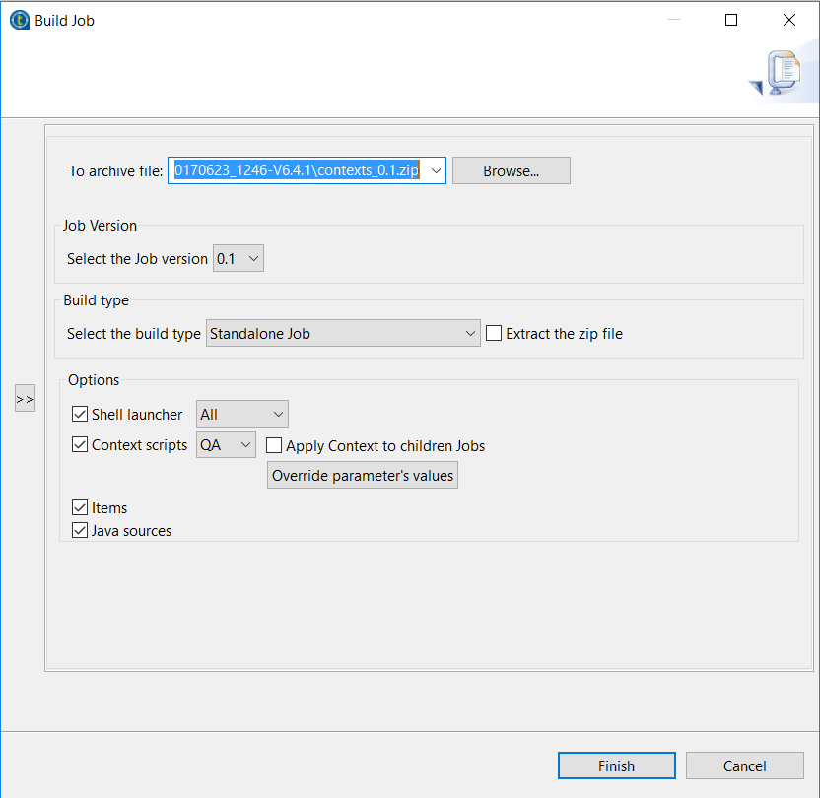
RUNNING JOBS
Building a Job
Running a Job as standalone

Slide 10
Thanks for your attention!
Any questions?
AUTHOR: Sergey Moukavoztchik
Lead Software Engineer
January, 2018

